Slide 1
DS501 Project 1 What motivates reviewer behavior?
Mia Barger ▪ Quincy Hershey ▪ Alexander Moore ▪ Ethan Prihar
https://www.yelp.com/dataset

Slide 2
Problem introduction + motivation
Is the Yelp reviewer base homogenous or reflecting distinct user populations and behaviors?
What do distinct subsets to the user base tell us about review bias and account creation?
What factors drive someone to make a Yelp account to leave a single negative review?

Slide 3
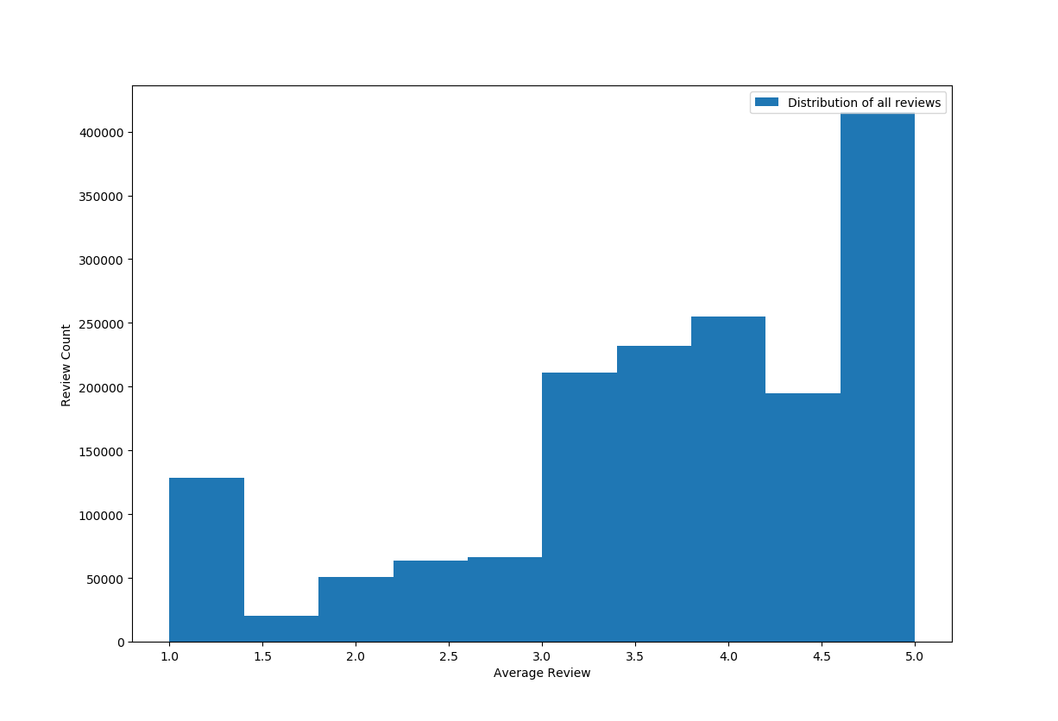
Exploring review distributions
All Reviews

Slide 4
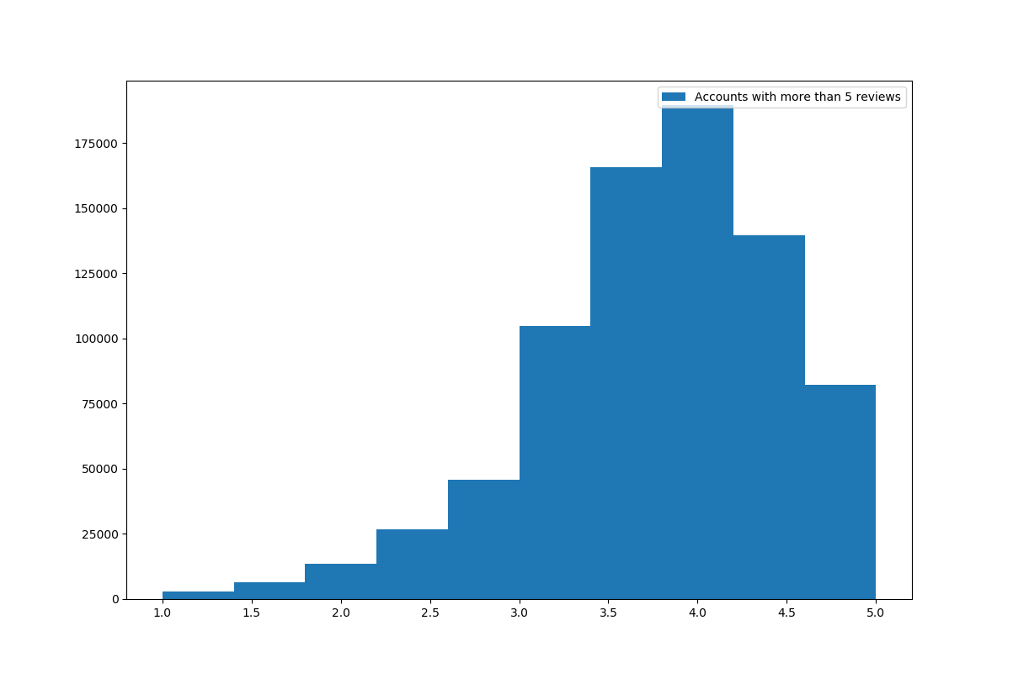
Exploring review distributions
>5 Reviews

Slide 5
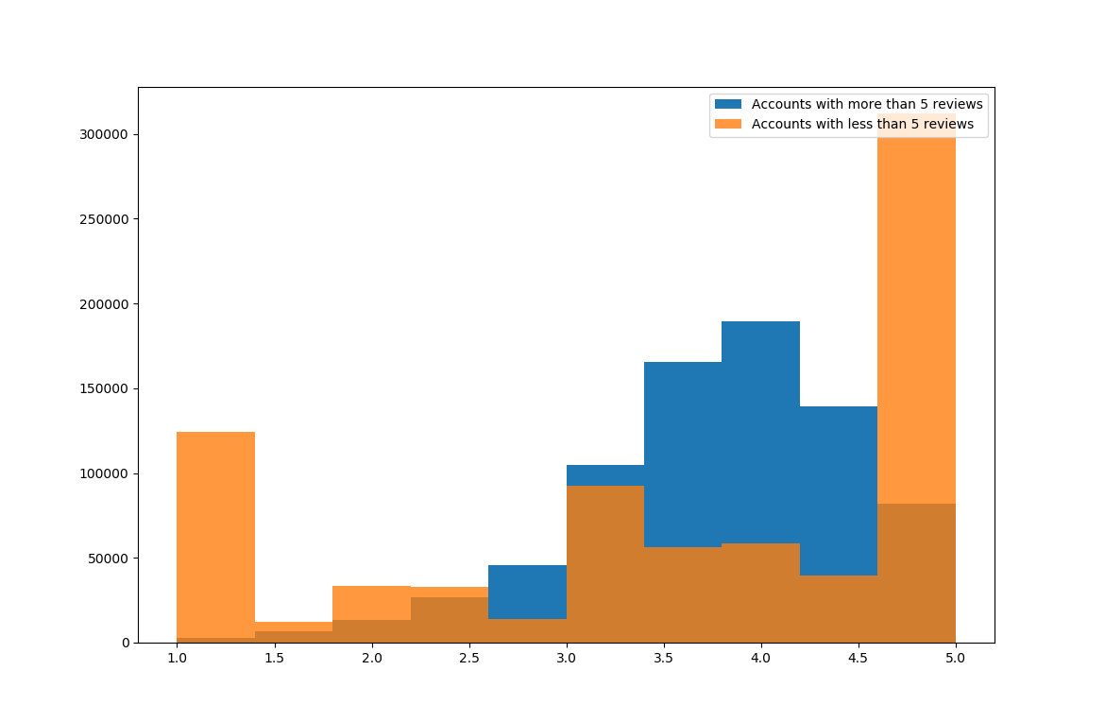
Exploring review distributions
>5 Reviews
<5 Reviews

Slide 6
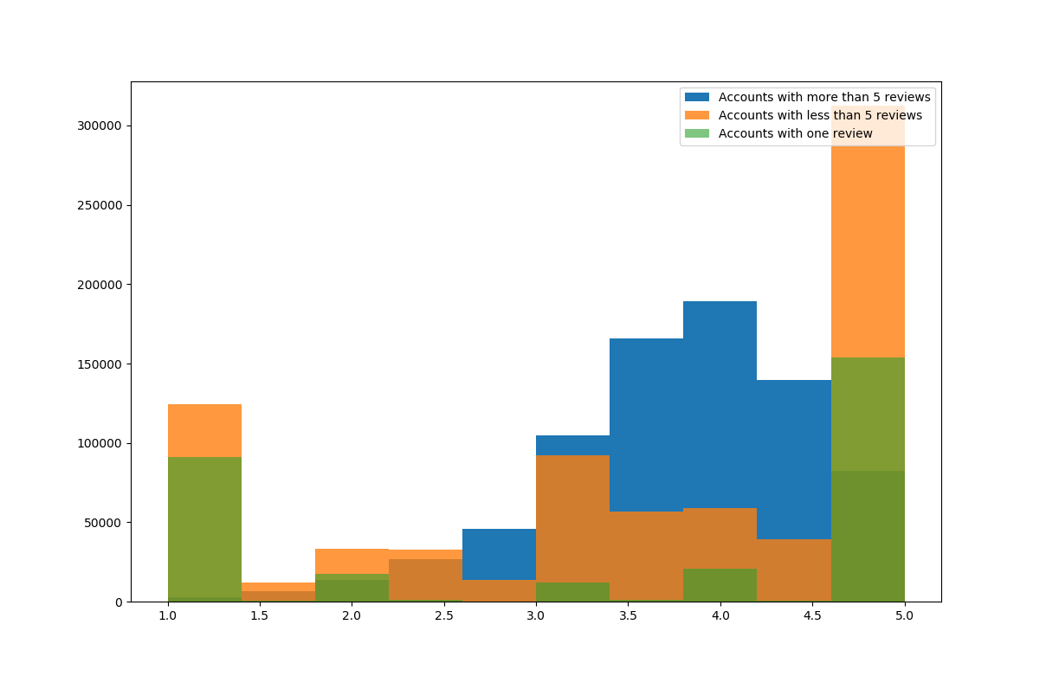
Exploring review distributions
>5 Reviews
<5 Reviews
<1 Review

Slide 7
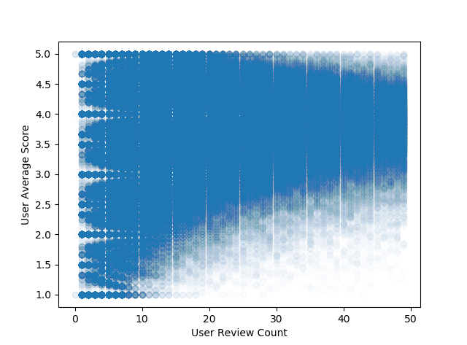
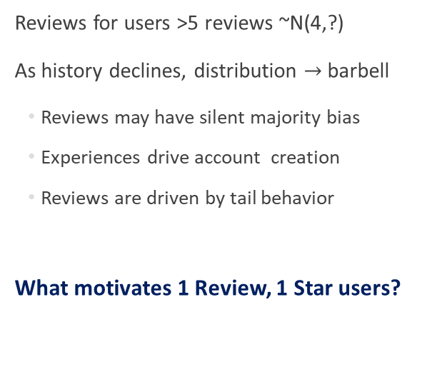
Initial takeaways
Reviews for users >5 reviews ~N(4,?)
As history declines, distribution $→$ barbell
Reviews may have silent majority bias
Experiences drive account creation
Reviews are driven by tail behavior
What motivates 1 Review, 1 Star users?

Slide 8
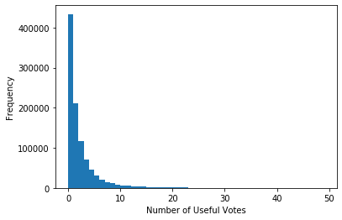
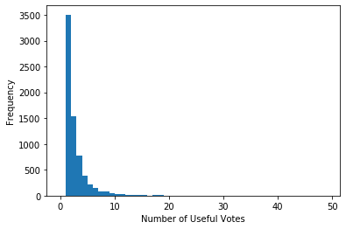
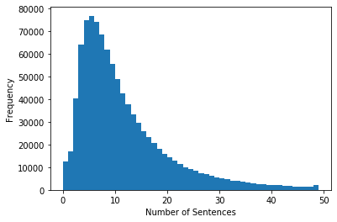
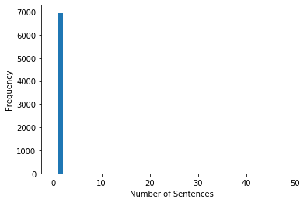
Step 1: Identify a relevant subset

Slide 9
Step 2: Extract review features
Embedding: A Neural Network Turns A List of Words into a Vector of Numbers
What the hell happened to this place, the new menu sucks, the size of servings shrunk, and the quality of the food is uber mediocre. Will not come anymore
me and my coworker waited for over an hour for just 2 bowl of phos. and wheb we asking waitress about our orders the waitress just walked away
[ 0.00746889 -0.04002672 0.11342745 ... 0.00595205 0.07626151 -0.00635999]
[ 0.00746889 -0.01814748 0.04581 ... 0.02196765 0.08440708 -0.00887392]

Slide 10
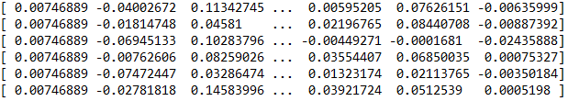
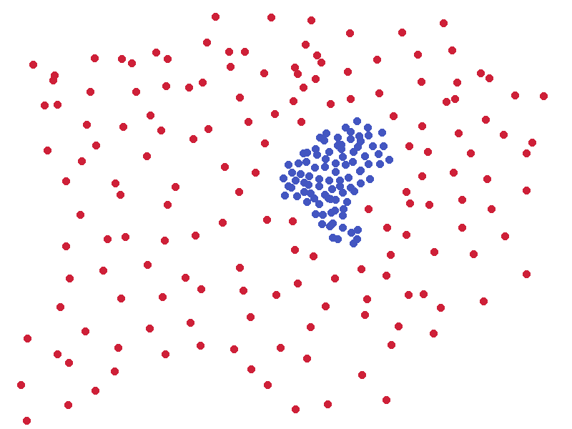

Step 3: Group similar reviews
DBSCAN: A clustering algorithm that clusters based on density

Slide 11
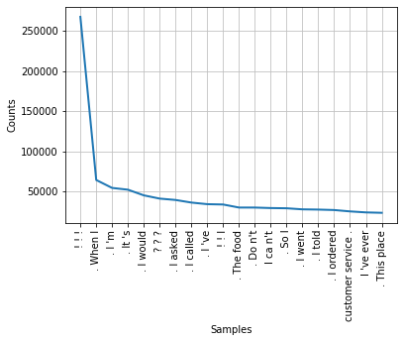

Step 4: Identify Common Phrases
All one star reviews
! ! !
. When I
. I ’m
. It’s
. I would
? ? ?
. I asked
. I called
. I ’ve
! ! I
. The food
. Do n’t
I ca n’t
. So I
. I went
. I told
. I ordered
customer service.
I’ve ever
. This place
BEFORE

Slide 12
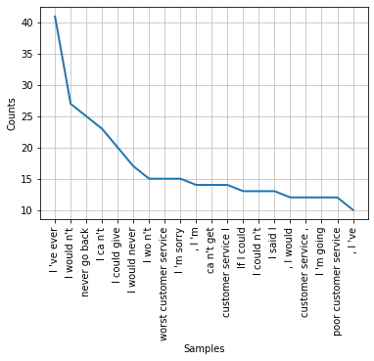

Step 4: Identify Common Phrases
Reviews from clustering
I ‘ve ever
I would n’t
never go back
I ca n’t
I could give
I would never
I wo n’t
worst customer service
I ‘m sorry
, I ‘m
ca n’t get
customer service I
If I could
I could n’t
I said I
, I would
customer service ,
I ‘m going
poor customer service
, I ‘ve
AFTER

Slide 13
Conclusion and business implications
Make sure you have good customer service. Tail events drive reviews.
Is Yelp’s “Don’t Ask for Reviews” policy fighting one bias with another?
Are there better ways to incentivize account creation and cope with free riders?
“Your most unhappy customers are your greatest source of learning”
~Bill Gates
https://www.yelp.com/dataset

